Slide 1

Machine Learning Project
Submitted by
AYUSH YADAV

Slide 2
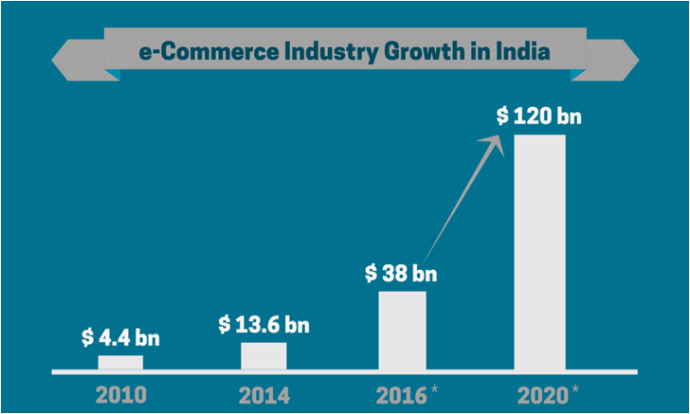
There has been an exponential growth of the E-Commerce Industry in the past few decades.

Slide 3

E-Commerce brands in India

Slide 4

Customer Churn
Main Risk to these E-Commerce brands is churning away of customers.

Slide 5


E-Commerce Industry Problem: Customer Retention
-The fierce competition in E-commerce has forced the companies to focus on providing customer satisfaction and gain
customer loyalty.
-Thus, measuring the parameters which drive customer satisfaction is very important for the long-term
growth of the businesses.
What E-Commerce Industry knows-
-Customers history of shopping online. Their preferences, what they like what they don’t
What E-Commerce Industry dosen’t know-
-Customer’s likelihood of keep buying from the same e=commerce brand

Slide 6
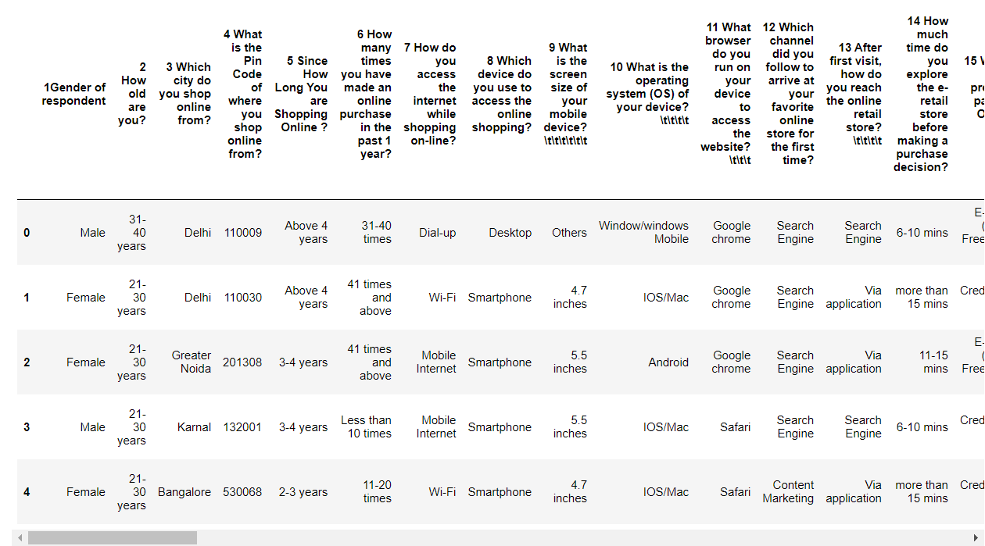
Data Shared
Task
Online shopping Analysis
Data
269 rows, 71 columns
Predictors
Customer activity
Response
Recommendation to friend or not

Slide 7
About the Customers
There is double the number of women than men who have taken this survey.
Most of the people are in their 30's followed by 20's, teenagers and senior citizen are the least in number.
Most of the people belong from Delhi, Noida and banglore, ambiguity can also be seen as noida has two categories (noida and greater noida) which need to be handled
Most of the people shopping online have been shopping from a long time.
Majority of people shop online 10 times a year, amiguity can also be seen for range 42 times and above which needs to be handled

Slide 8
Customer Loyalty
People shopping from amazon and paytm are getting benefits from the loyalty points, flipkart and sanpdeal also seem to give such benefits but people who shop from almost everywhere disagree with this statement too
Customers seem to be more loyal to amazon, flipkart and paytm as even though many of them have given negative remarks about them still they would recommend these platforms to their friend
Almost all the people who have shopped from amazon, flipkart and paytm are satisfied. People who shop from a more number of online brands dosent seem to be satisfied.

Slide 9
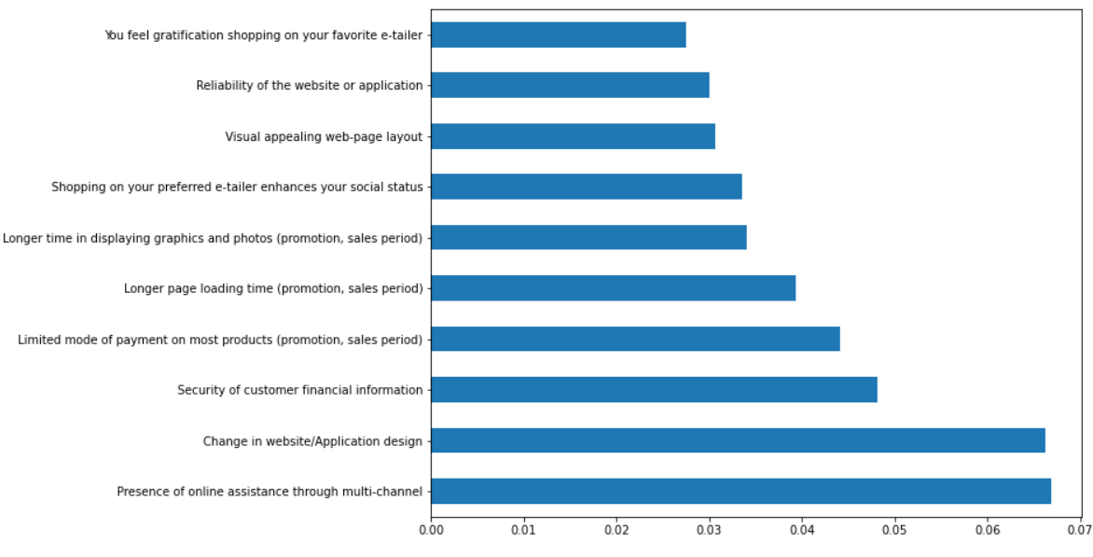
Important features in order to satisfy a customer according to feature importance of Random Forest Classifier

Slide 10
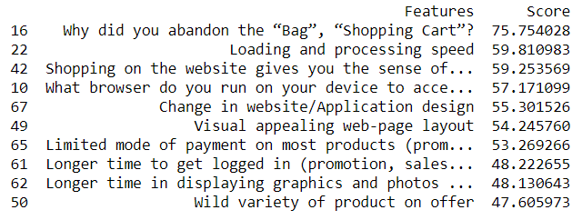
Important features in order to satisfy a customer according to Chi2 test.

Slide 11
Now, We try to create a model which will ill predict which e-commerce brand will the customer recomment to his/her friend

Slide 12
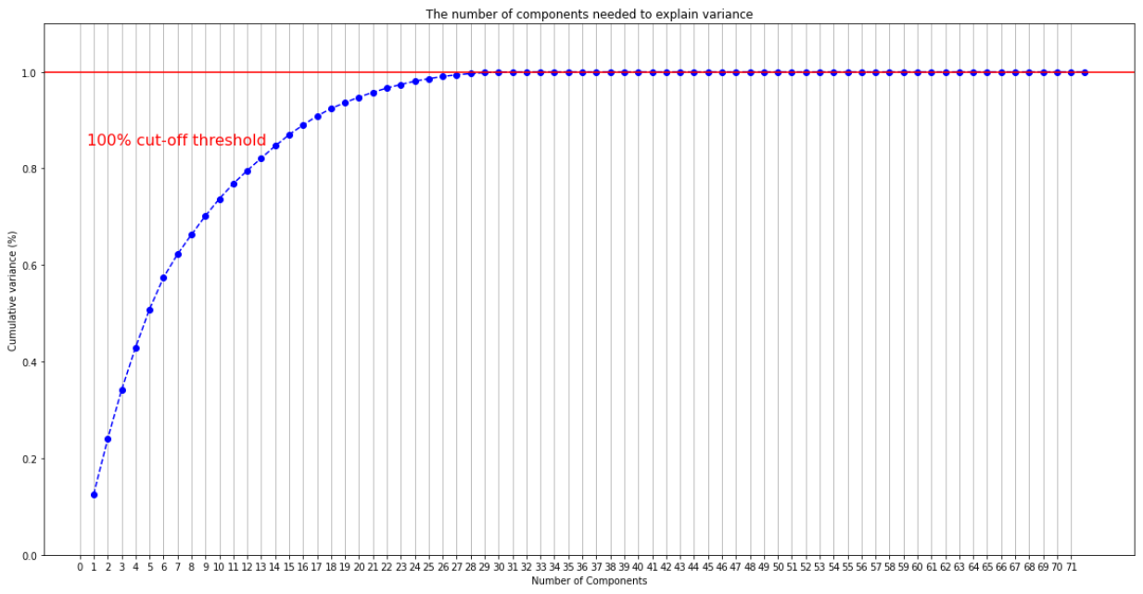
Since there are a large number of columns we perform principle component analysis (PCA) and find out that reducing the features to 29 will also let us keep 100% information.

Slide 13

Performance of Models
Model | Accuracy | K-Fold Score
Random Forest | 100% | 99.26
Extreme Gradient Boosting | 100% | 99.26
Conclusion:- Both the models give accurate and equal results so we choose xgboost as or final model because of its quick speed.

Slide 14

YOUR SUGGESIONS!!!
Improvising
On what criteria we have performed analysis
What we look forward to use
Removing unrealistic responses
Most importantly,
Intention of Repeat purchase
Online Retailing
Brand image
Brand satisfaction
Loyalty
Satisfaction

Slide 15

Thank you

